Slide 1
www.MINEPORTAL.in
ONLINE TEST SERIES FOR
DGMS COAL/METAL FIRST/SECOND CLASS EXAM
GATE MINING EXAM
OVERMAN EXAM TEST
MINING INSPECTOR EXAMS
COAL INDIA MTs & OTHER PSUs EXAMS
FREE STUDY MATERIAL & VIDEO LECTURES
MINING JOBS NOTIFICATIONS
www.mineportal.in Call/Whatsapp-8804777500 www.fb.com/mineportal.in

Slide 2
Computer application in pillar design

Slide 3
Coal Pillars Design Approaches:
Ultimate Strength: The design determines the strength of a pillar on the basis of its geometry, size and the compressive strength of the material.
This approach will compare the expected load of the pillar to its ultimate strength to determine its safety factor value.
The main assumption of this approach is that, once the ultimate strength is overcome the pillar will have zero strength, which is not strictly true in reality.
Progressive Failure: The design assumes a non-uniform stress distribution within the pillar.
The failure of a pillar begin at the point of ultimate strength, and gradually progresses to ultimate failure.
Wilson Core Model
Diest Strain Softening Model
Numerical Models can adopt both ultimate strength and progressive failure approaches.

Slide 4
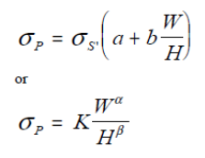
Traditionally, all pillar design formulas employ the ultimate strength theory. Each of these "classic" pillar design formulas consisted of three steps:
Estimating the pillar load
Estimating the pillar strength
Calculating the pillar safety factor.
Classic empirical pillar strength formulas usually follow one of two general forms.
where σp= pillar strength; σp = strength of insitu coal or rock; W = pillar width; H= mining height; α and β are regression constant and K = a constant depending on the field
Pillar strength formulas by Obert and Duvall (1967) and Bieniawski (1968), Sheorey follow the first form, whereas formulas by Salamon and Munro (1967) and Holland (1964) follow the second.

Slide 5
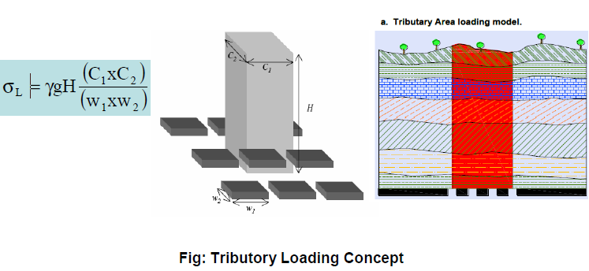
Pillar Loading
Estimation of loading on the pillar of Bord and Pillar mines based on tributary area loading concept.

Slide 6
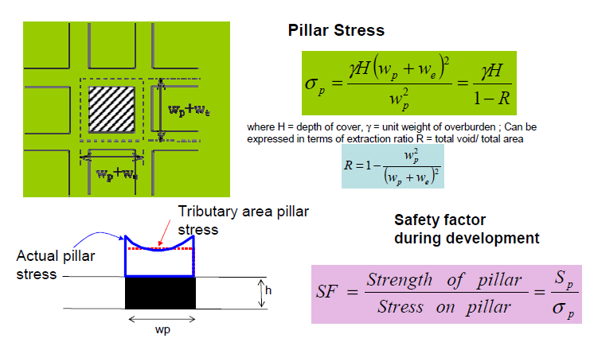
Stress in pillar by Tributary area method

Slide 7
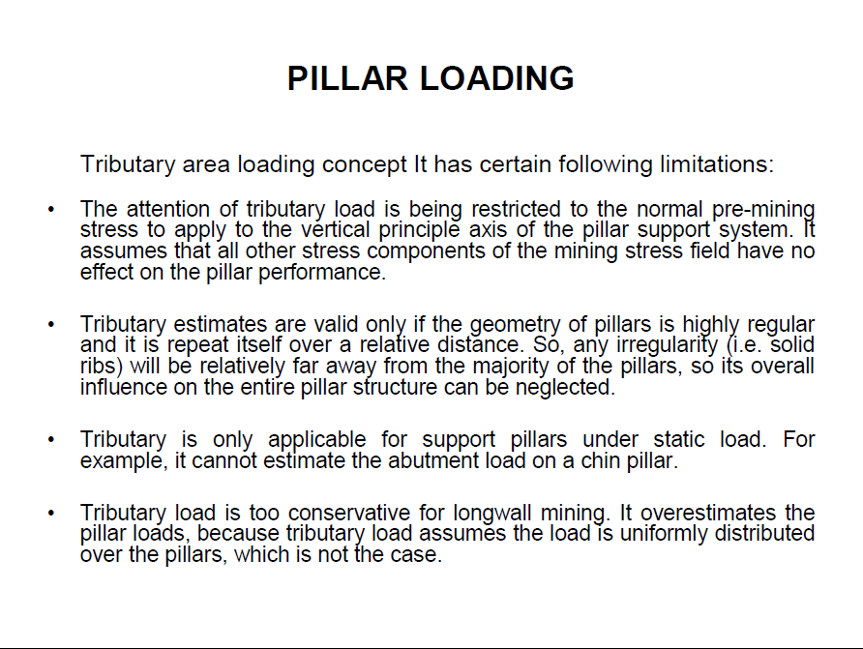

Slide 8
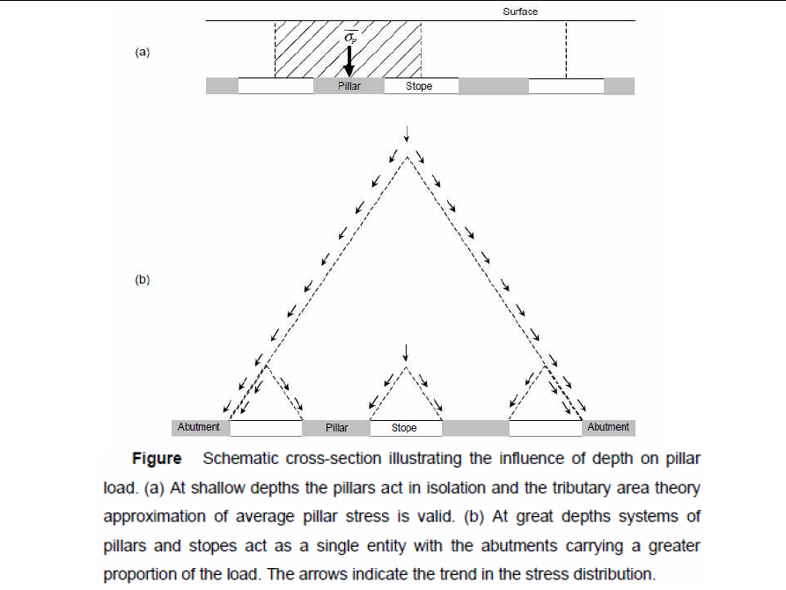

Slide 9
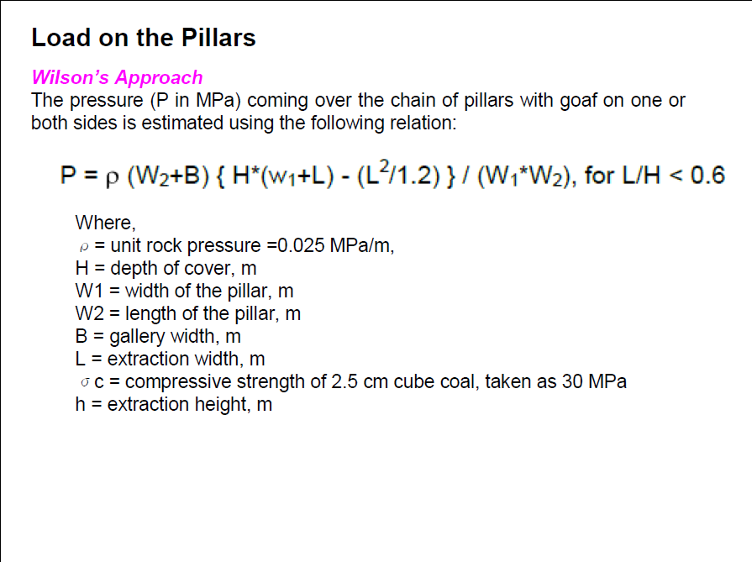

Slide 10
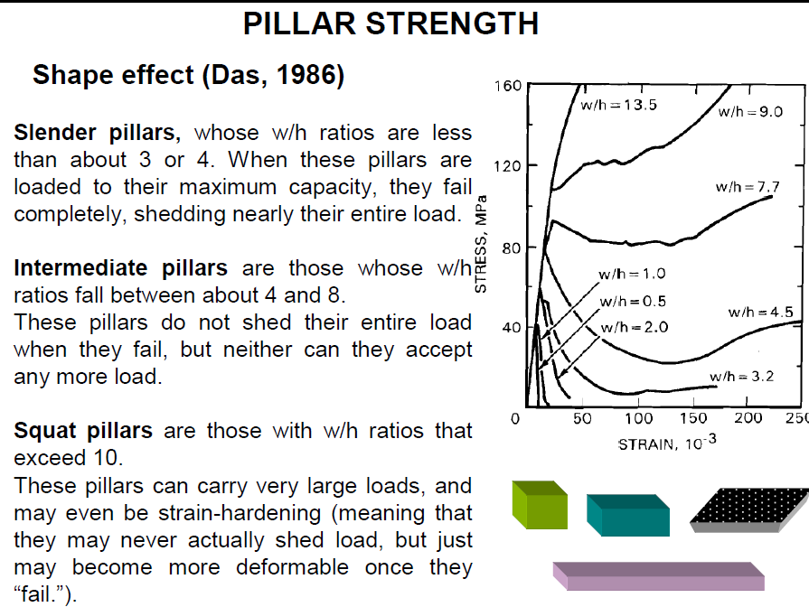

Slide 11
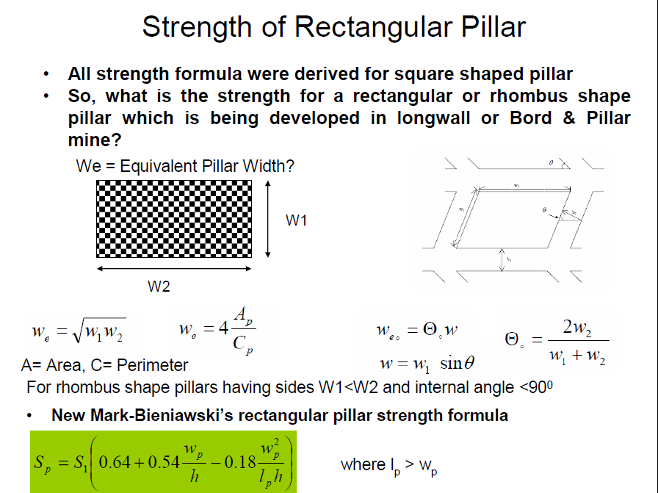

Slide 12
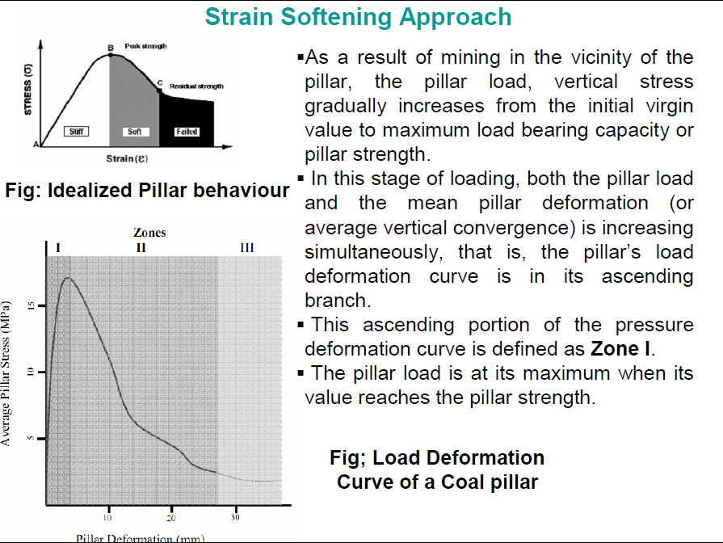

Slide 13
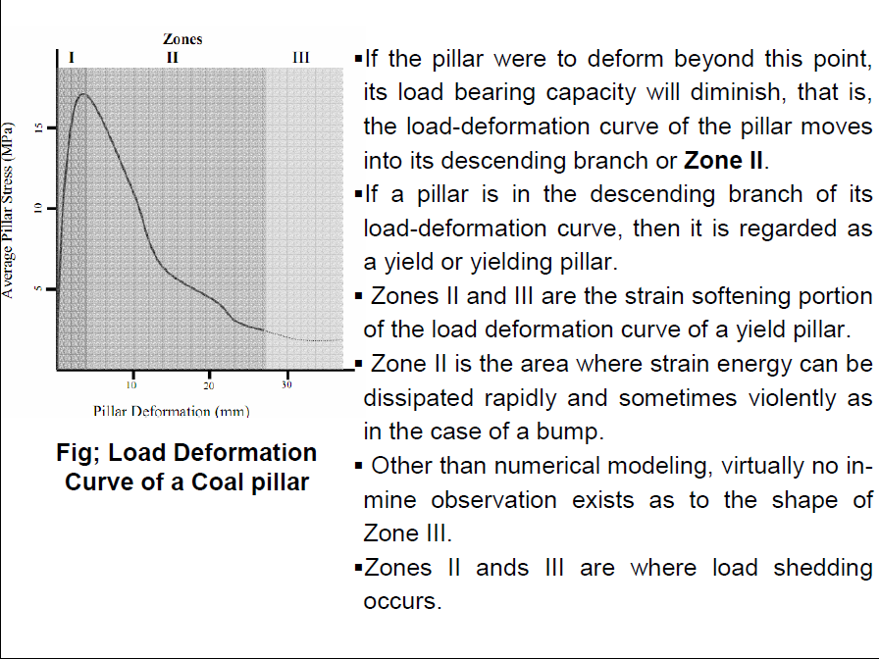

Slide 14
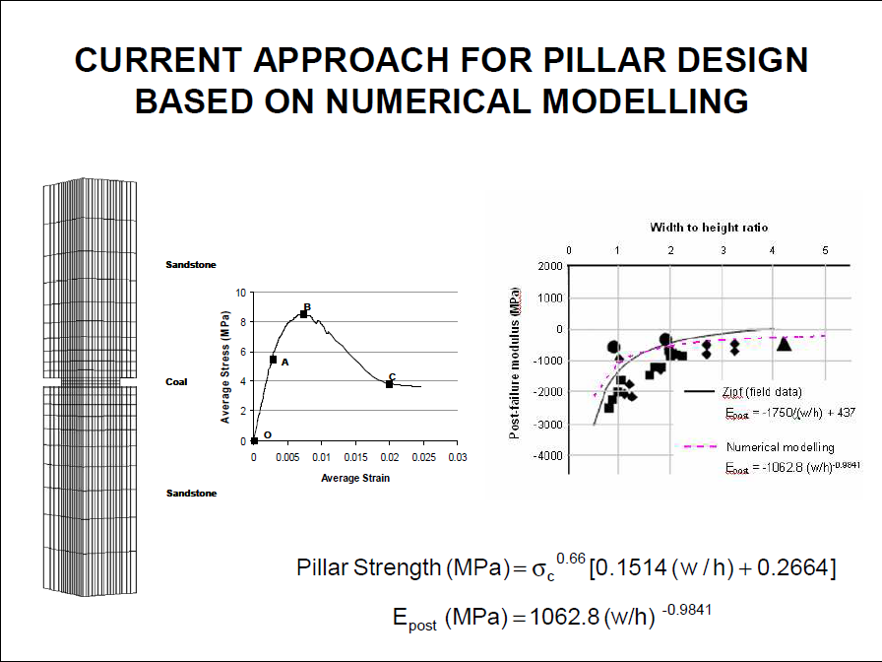

Slide 15
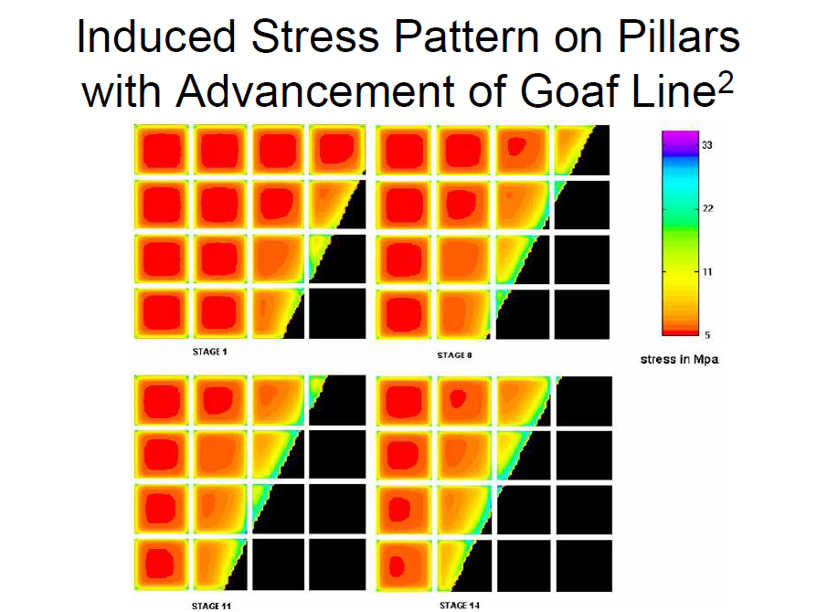

Slide 16
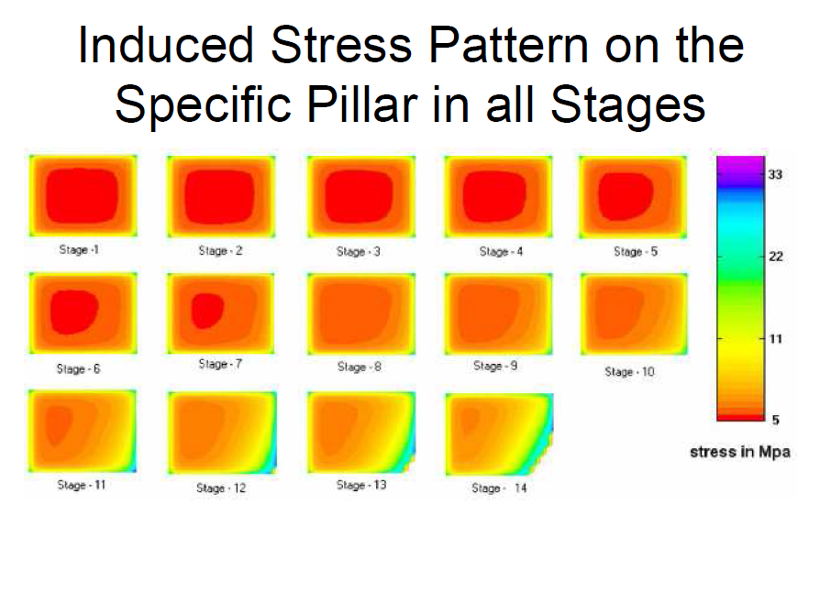

Slide 17
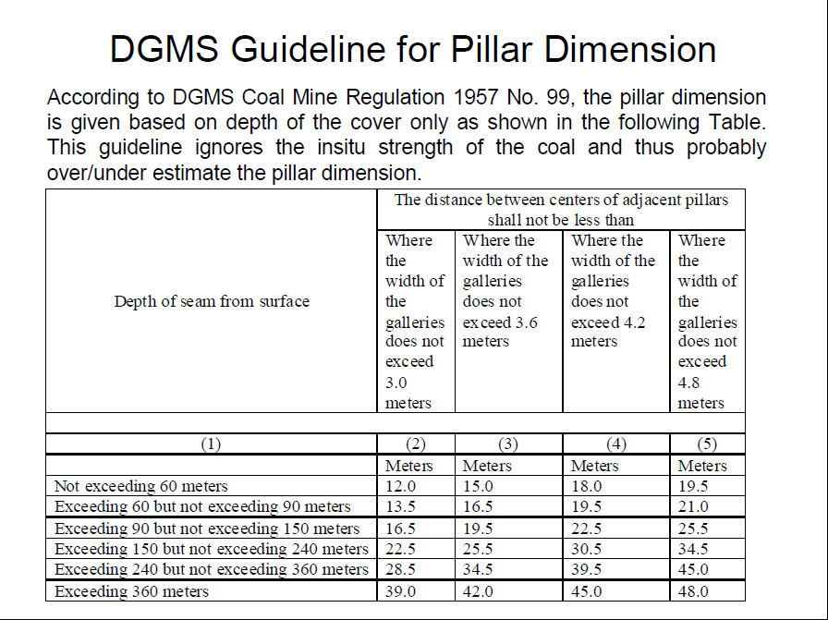

Slide 18
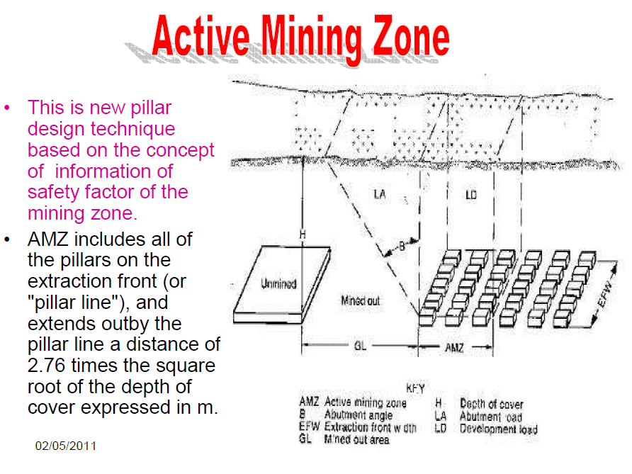

Slide 19
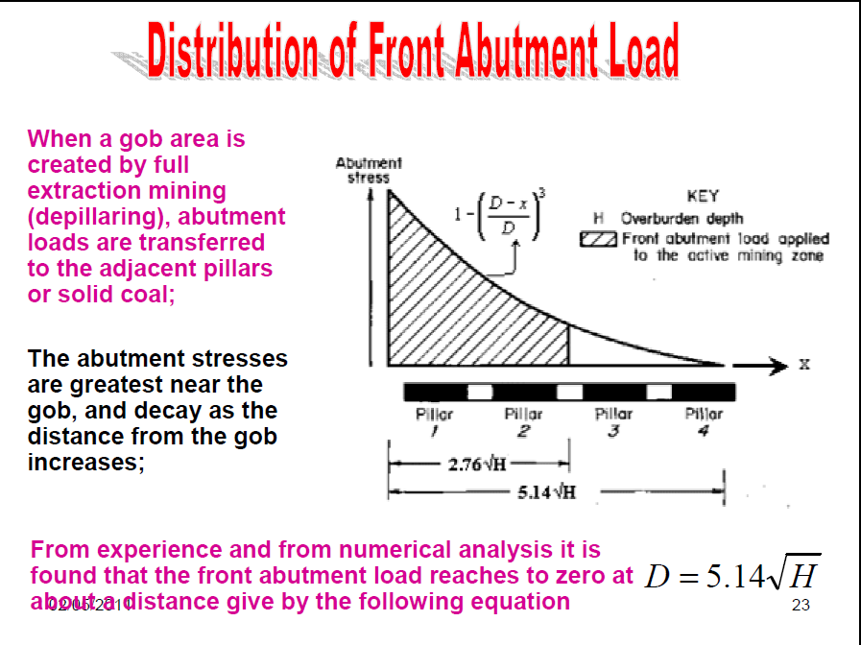

Slide 20
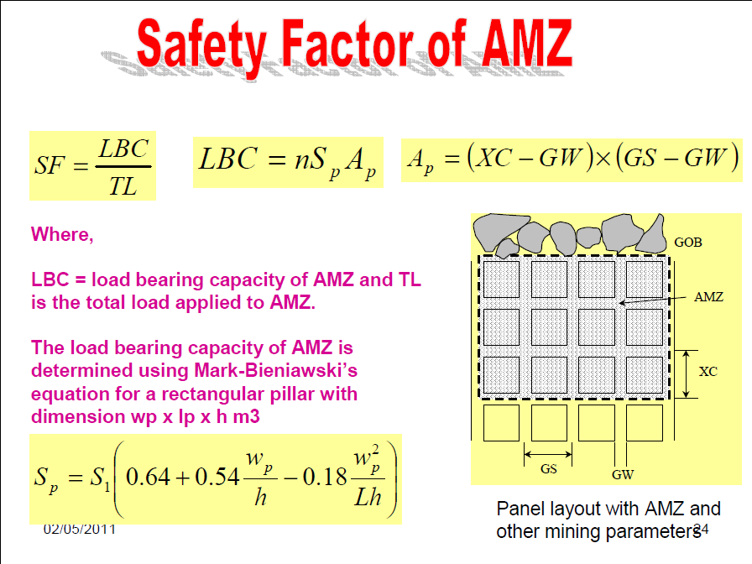

Slide 21
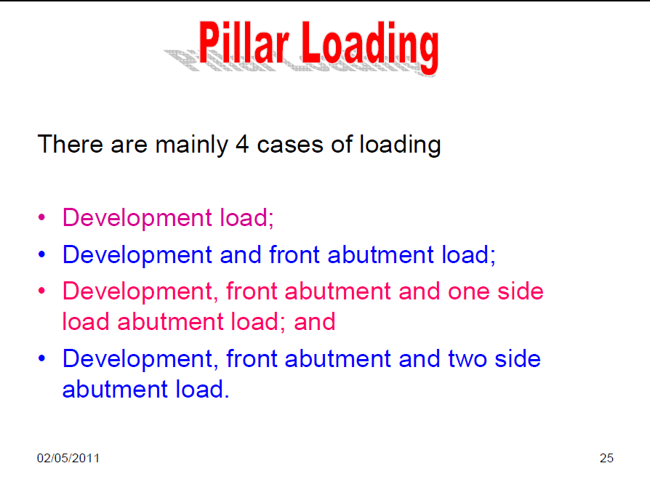

Slide 22
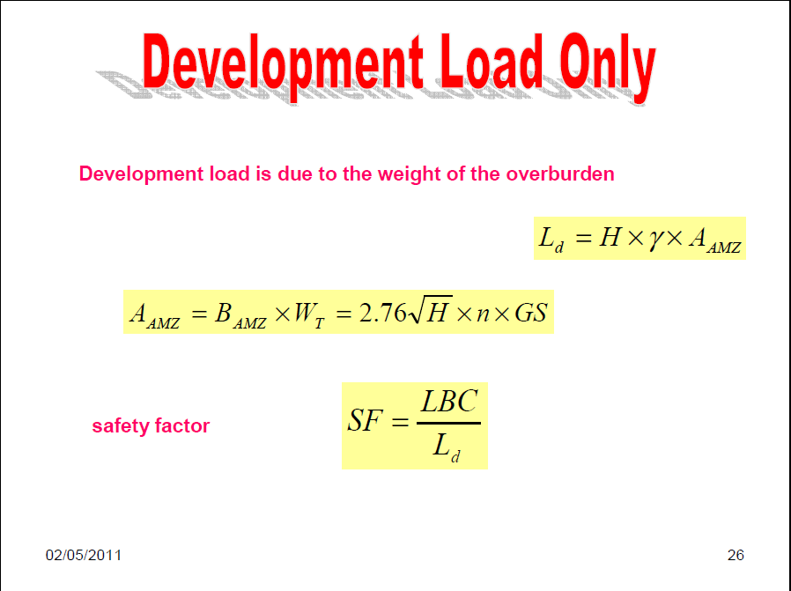

Slide 23
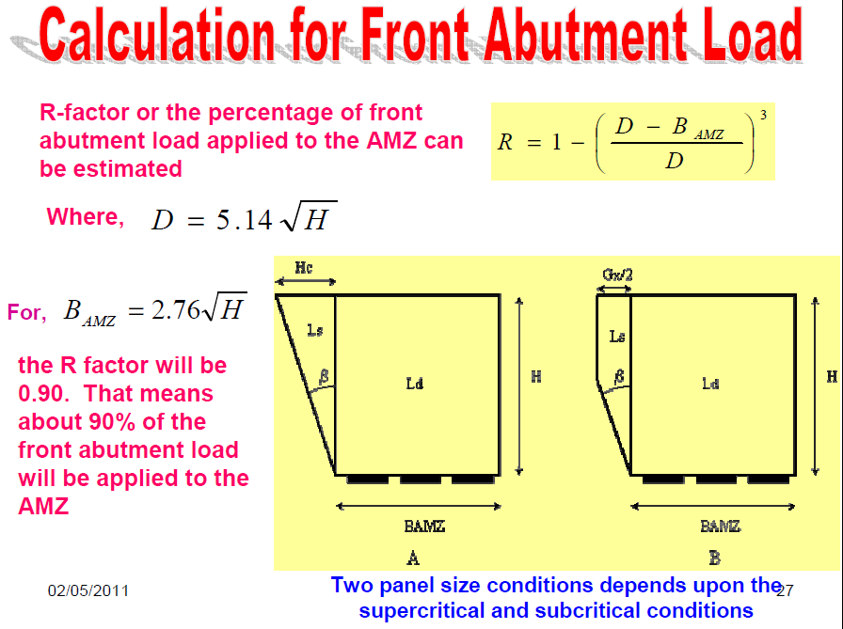

Slide 24
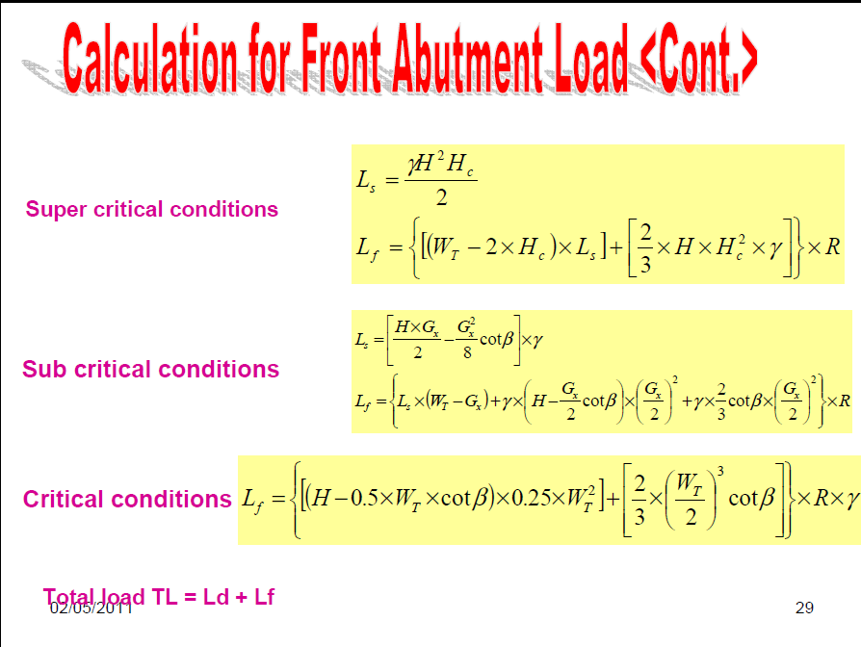

Slide 25
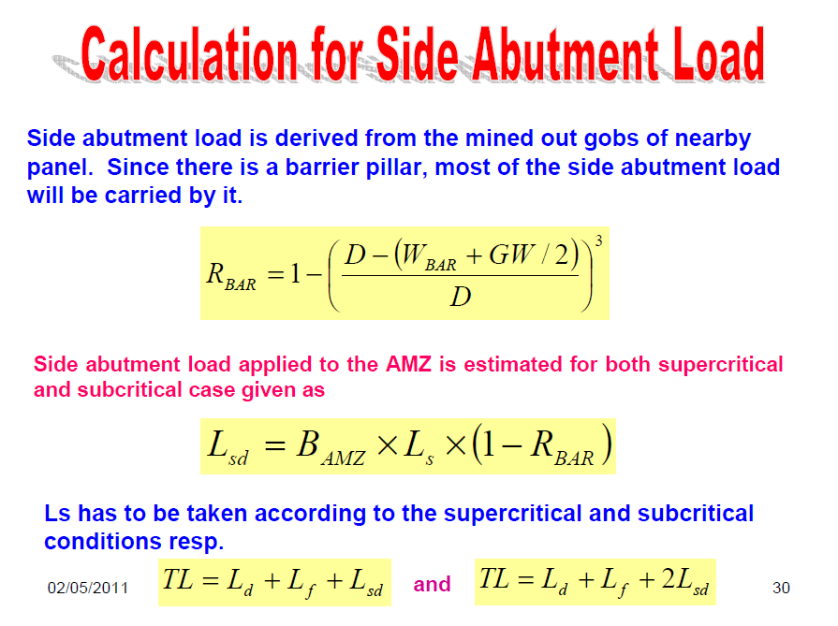

Slide 26
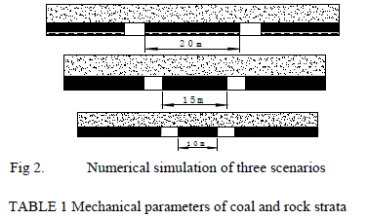
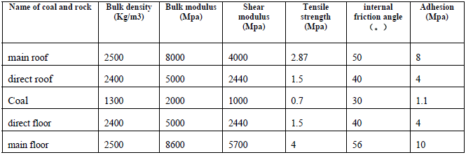
The Numerical Simulation and Test of the Coal Pillar Size

Slide 27
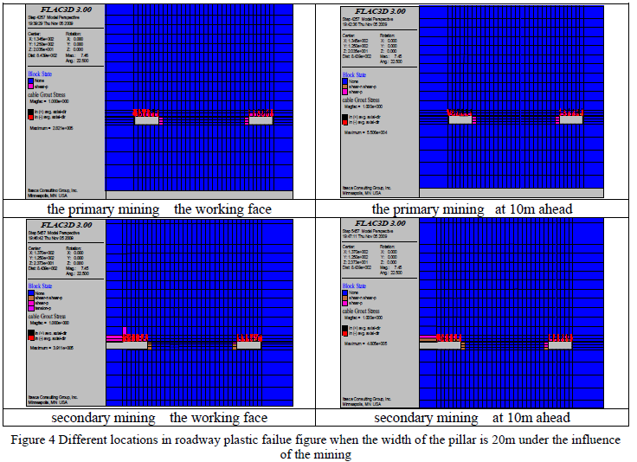

Slide 28
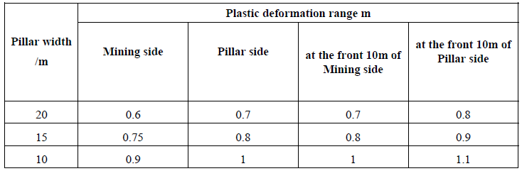
Plastic Deformation

Slide 29
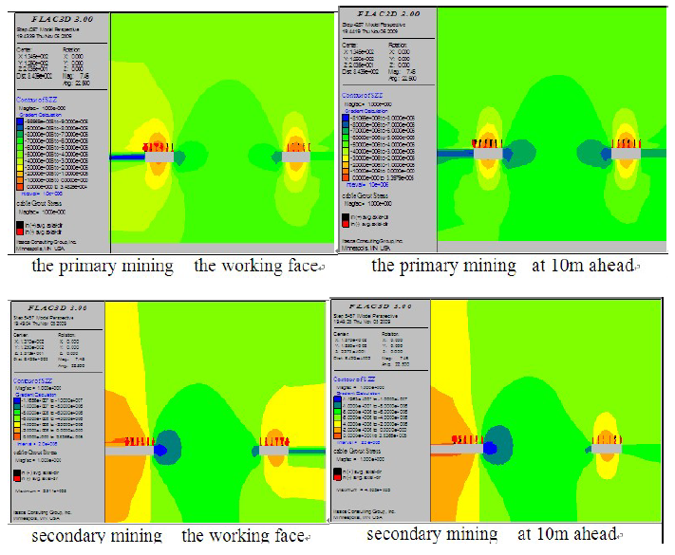
Vertical stress distribution at different position in the pillar under the influence by the mining when the pillar width is 20m

Slide 30
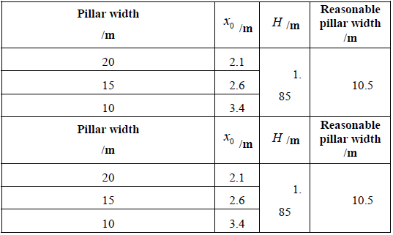
PLASTIC ZONE SIZE UNDER DIFFERENT PILLAR WIDTH AND REASONABLE PILLAR WIDTH

Slide 31
Prepared by- 11108EN023 – 11108EN032

